Slide 1
Lecture 5: Local asynchronous Transmission
Transmission modes
Transmission is the manner in which data is sent over the underlying medium. There are two fundamental categories:
Serial, that is sending one bit at a time over a communication medium
Parallel, that is sending multiple bits at the same time
Transmission modes can further be classified as shown in figure 20 below:

Slide 2
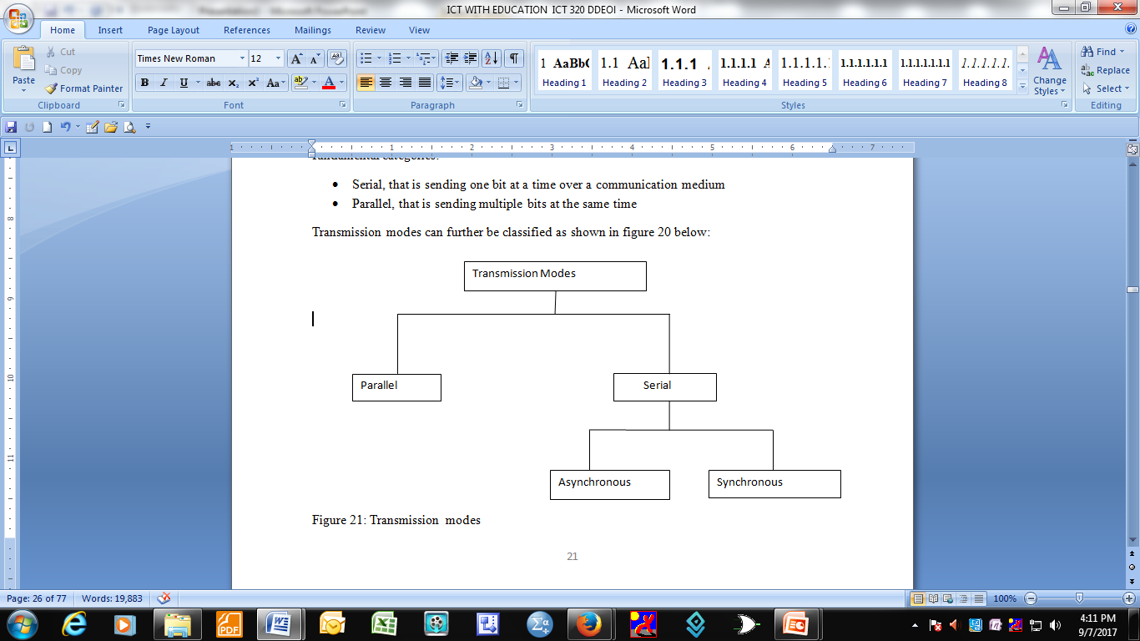

Slide 3
Parallel transmission:
- sending of multiple data bits at the same time over separate data lines
- parallel transmission is used with wired medium that uses multiple independent wires.
- signals on all the wires are synchronized so that a bit propagates across each of the wires precisely at the same time(see figure 22 below).

Slide 4
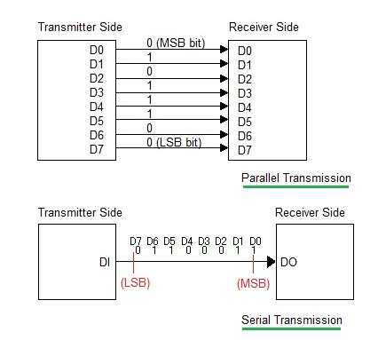

Slide 5
In figure above D0 –D7 represent the wires that carry the data bits from the transmitter side (sender) to the receiver side (receiver).
The wire D0 carry the most significant bit (MSB) and D7 carry the least significant bit (LSB).
In addition to parallel wires that carry data, a parallel interface contains wires that allow the sender and the receiver to coordinate (not shown in figure 22).

Slide 6
Advantages of parallel transmission
High speed because a parallel interface can send N bits at the same time, that is N times faster than an equivalent serial interface.
A parallel interface matches the underlying computer hardware.
This is because internally computer and communication hardware use parallel circuitry.
So a parallel interface matches the internal hardware very well.

Slide 7
Disadvantages of parallel transmission
High cost of implementation. This arises from the fact that each bit requires its own line, so transferring several bits in parallel means providing several channels, several transmitters and several receivers
The signals do not arrive at the receiver at the same time. This problem is known as a skew and obviously this fault will increase in severity as distance between sender and receiver grows larger

Slide 8
Serial transmission
This is the alternative to parallel transmission.
In data communications emphasis is on speed.
There are two major reasons why serial communication is preferred to parallel:
Networks using serial mode can be extended over long distances at much less cost because fewer physical wires are needed and the intermediate components are less expensive .
The use of a single wire eliminates the skew problem prevalent in parallel transmission systems.

Slide 9
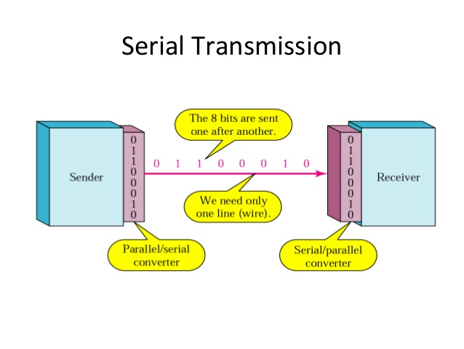

Slide 10
Hardware needed to convert from parallel to serial and vice versa
As can be seen in the diagram above,
only one wire is needed to carry one bit at a time from the sender to the receiver.
However there is need for hardware to convert from parallel to serial and from serial to parallel.
Parallel to serial converter is needed to covert signals from the computer from parallel interface to serial and a serial to parallel converter is needed to convert from serial to parallel.
In practice the two converters are combined because the process of converting from serial/parallel is done at both ends.

Slide 11
Transmission Order (Bits and Bytes)
Need to know which bit should be transmitted first MSB or LSB bit?
In data communications circles the terms big-endian and little-endian are used to distinguish the order of transmission.
The term big-endian is used to describe a communications system that sends the MSB first.
Either of the two forms can be used but the transmitter (Sender) and the receiver must agree.

Slide 12
Since data in computers is organized in bytes and each byte is in turn divided into bits (8 bits), it is possible to choose a byte order and a bit order independently. Ethernet technology specifies that data be sent byte big- endian and bit little-endian.

Slide 13
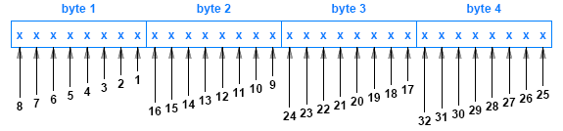

Slide 14
The hardware for making these conversions (parallel to serial and serial to parallel) can be simple and straight forward or can be complex depending on the serial communication mechanism. In its simplest case, a single chip known as a Universal Asynchronous Receiver and Transmitter (UART) performs the conversions and a related chip called the Universal Synchronous Asynchronous Receiver and Transmitter (USART) handles the conversion for synchronous networks

Slide 15
Serial Transmission
Asynchronous transmission
asynchronous simply means not at the same time.
there is usually the clock confusion in asynchronous systems.
Students tend to think that asynchronous communication systems do not use clocks..

Slide 16
Asynchronous clocks
not true because they do use clocks but the clocked are independent -not synchronized
A communication system is classified as asynchronous:
if it allows the transmitting medium to be idle for an arbitrary time between two transmissions.
Lacks coordination between transmitter and receiver

Slide 17
Asynchronous overhead bits
Asynchronous systems /technologies usually transmit extra bits before each data is sent.
Idea is to inform the receiver that a data transfer is starting.
The extra bits allow the receiving mechanism to synchronize with the incoming signal.
The extra bits are known by various names such as preamble, synchronization bits (SYN bits) and in others start bits.

Slide 18
Asynchronous communications suitability
Type of communication suitable for
applications where data is generated randomly e. g a user entering data into the computer using a keyboard,
or when a user uses a mouse to click on a link to obtain a web page.

Slide 19
RS -232 Asynchronous character transmission
Asynchronous communication technology is regulated
by Electronic Industries Alliance (EIA)
Is widely accepted for character communication.
The letters RS stand for registered standard (RS-232). Popularly known as RS-232-C and commonly abbreviated RS -232, the EIA standard specifies the following:

Slide 20
RS-232 standards
Details of physical connection, for example the code must be less than 50 feet long
Electrical details( voltage varies from -15 volts - +15 volts)
Line coding(for example negative voltage corresponds to a logical 1 and positive voltage corresponds to a logical 0)
, RS -232 standard specifies that each data item must be a character(8 bits).

Slide 21
Exception
However the hardware can be configured to control the exact number of bits that can be transmitted per second
a sender can transmit all the bits of a character one after the other without any delays between them.
For a receiver to know that data is on the way, a sender transmits an extra bit usually a 0, called a start bit before transmitting the bits of a character used.

Slide 22
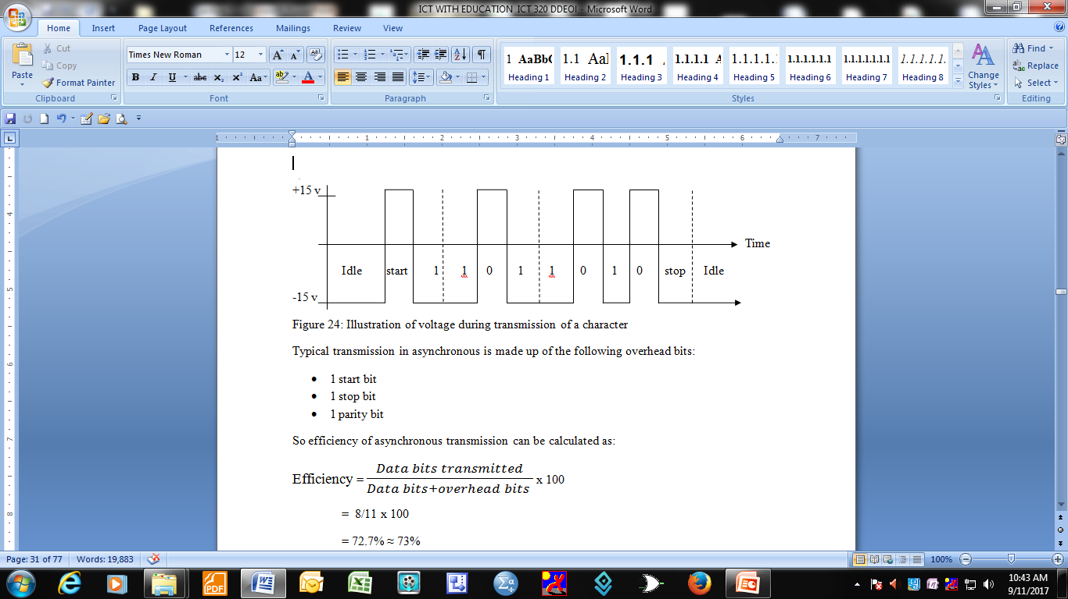

Slide 23
3 overhead bits in each character transmitted
Typical transmission in asynchronous is made up of the following overhead bits:
1 start bit
1 stop bit
1 parity bit
So efficiency of asynchronous transmission can be calculated as:

Slide 24
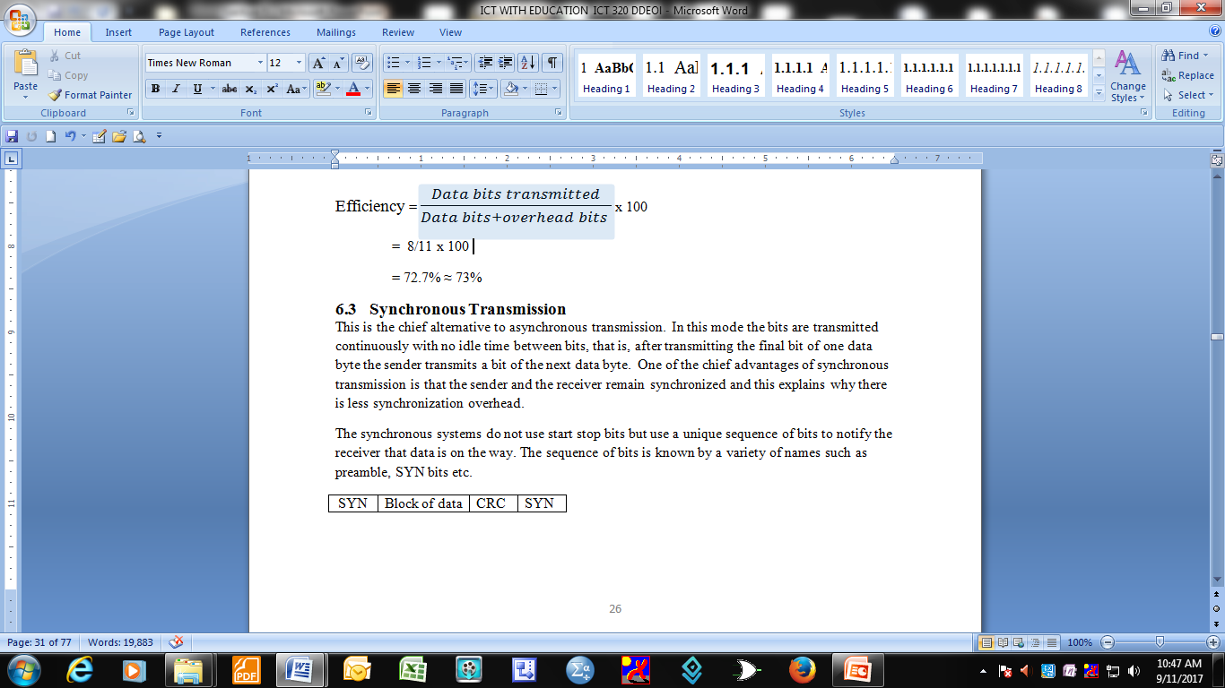
Calculating Efficiency

Slide 25
Synchronous Transmission
chief alternative to asynchronous transmission.
- the bits are transmitted continuously with no idle time between bits, that is, after transmitting the final bit of one data byte the sender transmits a bit of the next data byte.
- Receiver and sender remain synchronized - this explains why there is less synchronization overhead.
- No use start stop bits but use a unique sequence of bits to notify the receiver that data is on the way.

Slide 26
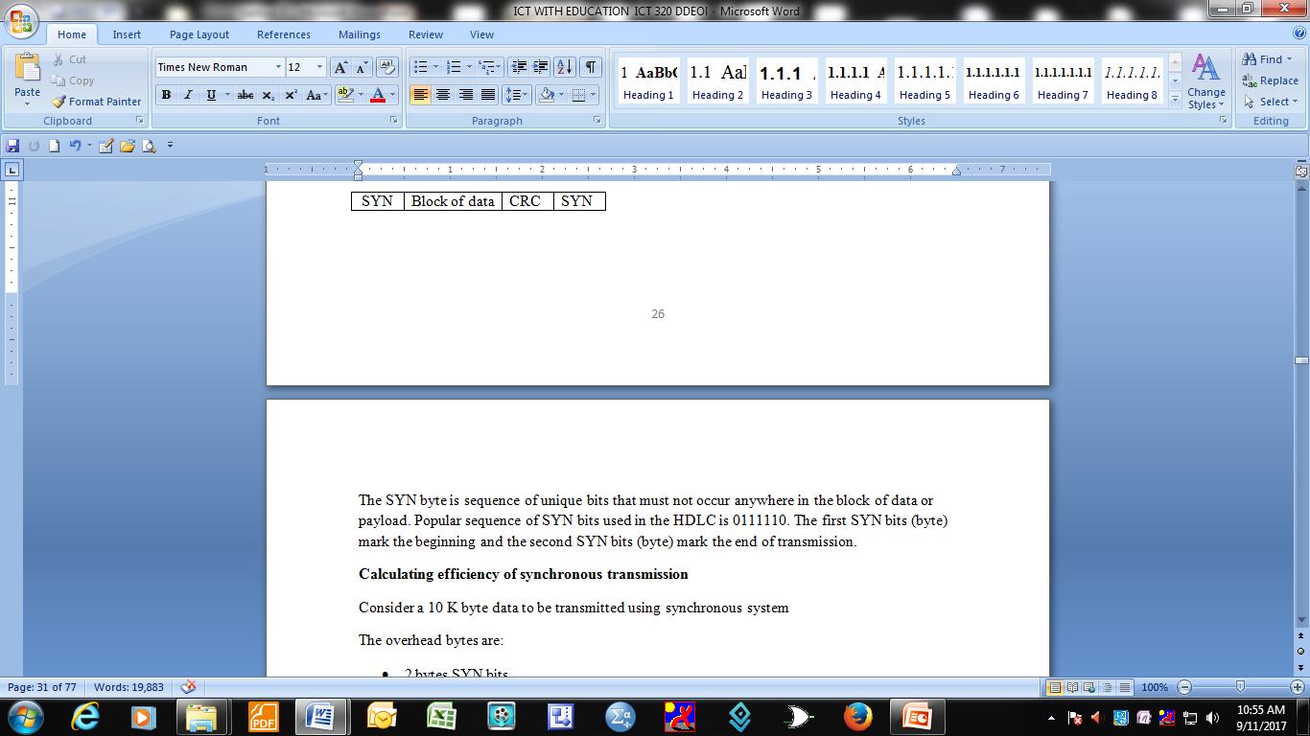
Synchronous frame
The sequence of bits is known by a variety of names:
- preamble,
- SYN bits etc.

Slide 27
The SYN byte is sequence of unique bits that must not occur anywhere in the block of data or payload.
Popular sequence of SYN bits used in the HDLC is 0111110.
The first SYN bits (byte) mark the beginning and the second SYN bits (byte) mark the end of transmission.

Slide 28
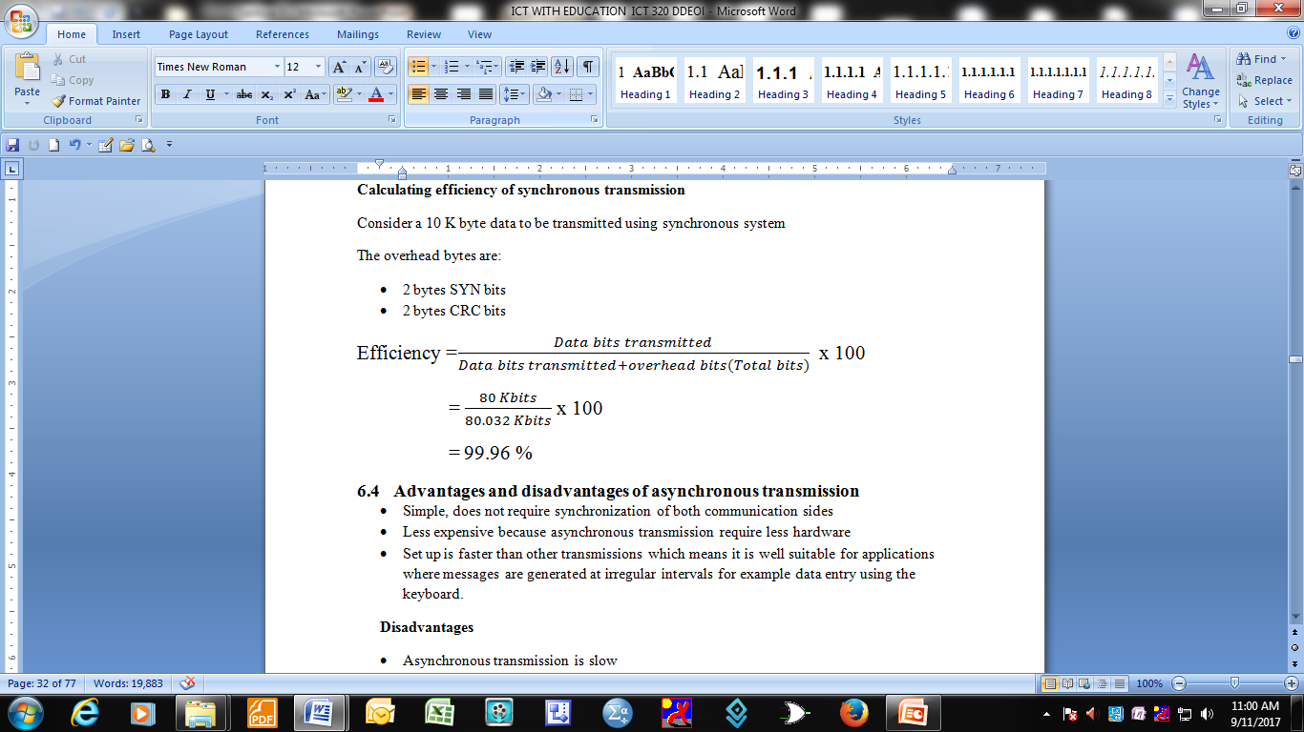
Calculating efficiency of synchronous transmission

Slide 29
Advantages of asynchronous transmission
Simple, does not require synchronization of both communication sides
Less expensive because asynchronous transmission require less hardware
Set up is faster than other transmissions which means it is well suitable for applications where messages are generated at irregular intervals for example data entry using the keyboard.

Slide 30
Disadvantages
Asynchronous transmission is slow
It has large relative overhead because a large portion of the transmitted bits are for control purposes.

Slide 31
Advantages and disadvantages of synchronous transmission
Advantages
Low overhead
Greater through put
Disadvantages
Slightly more complex
Hardware is more expensive

